Slide 1
SUBLIMINAL
An experience unlike any other.
In the palm of your hand.

Slide 2
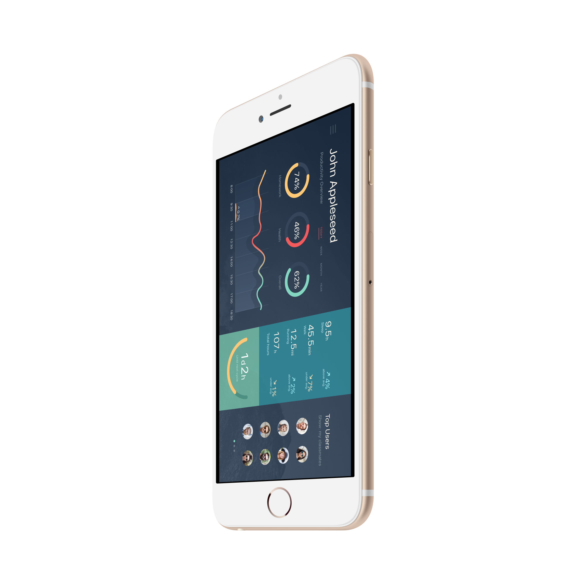
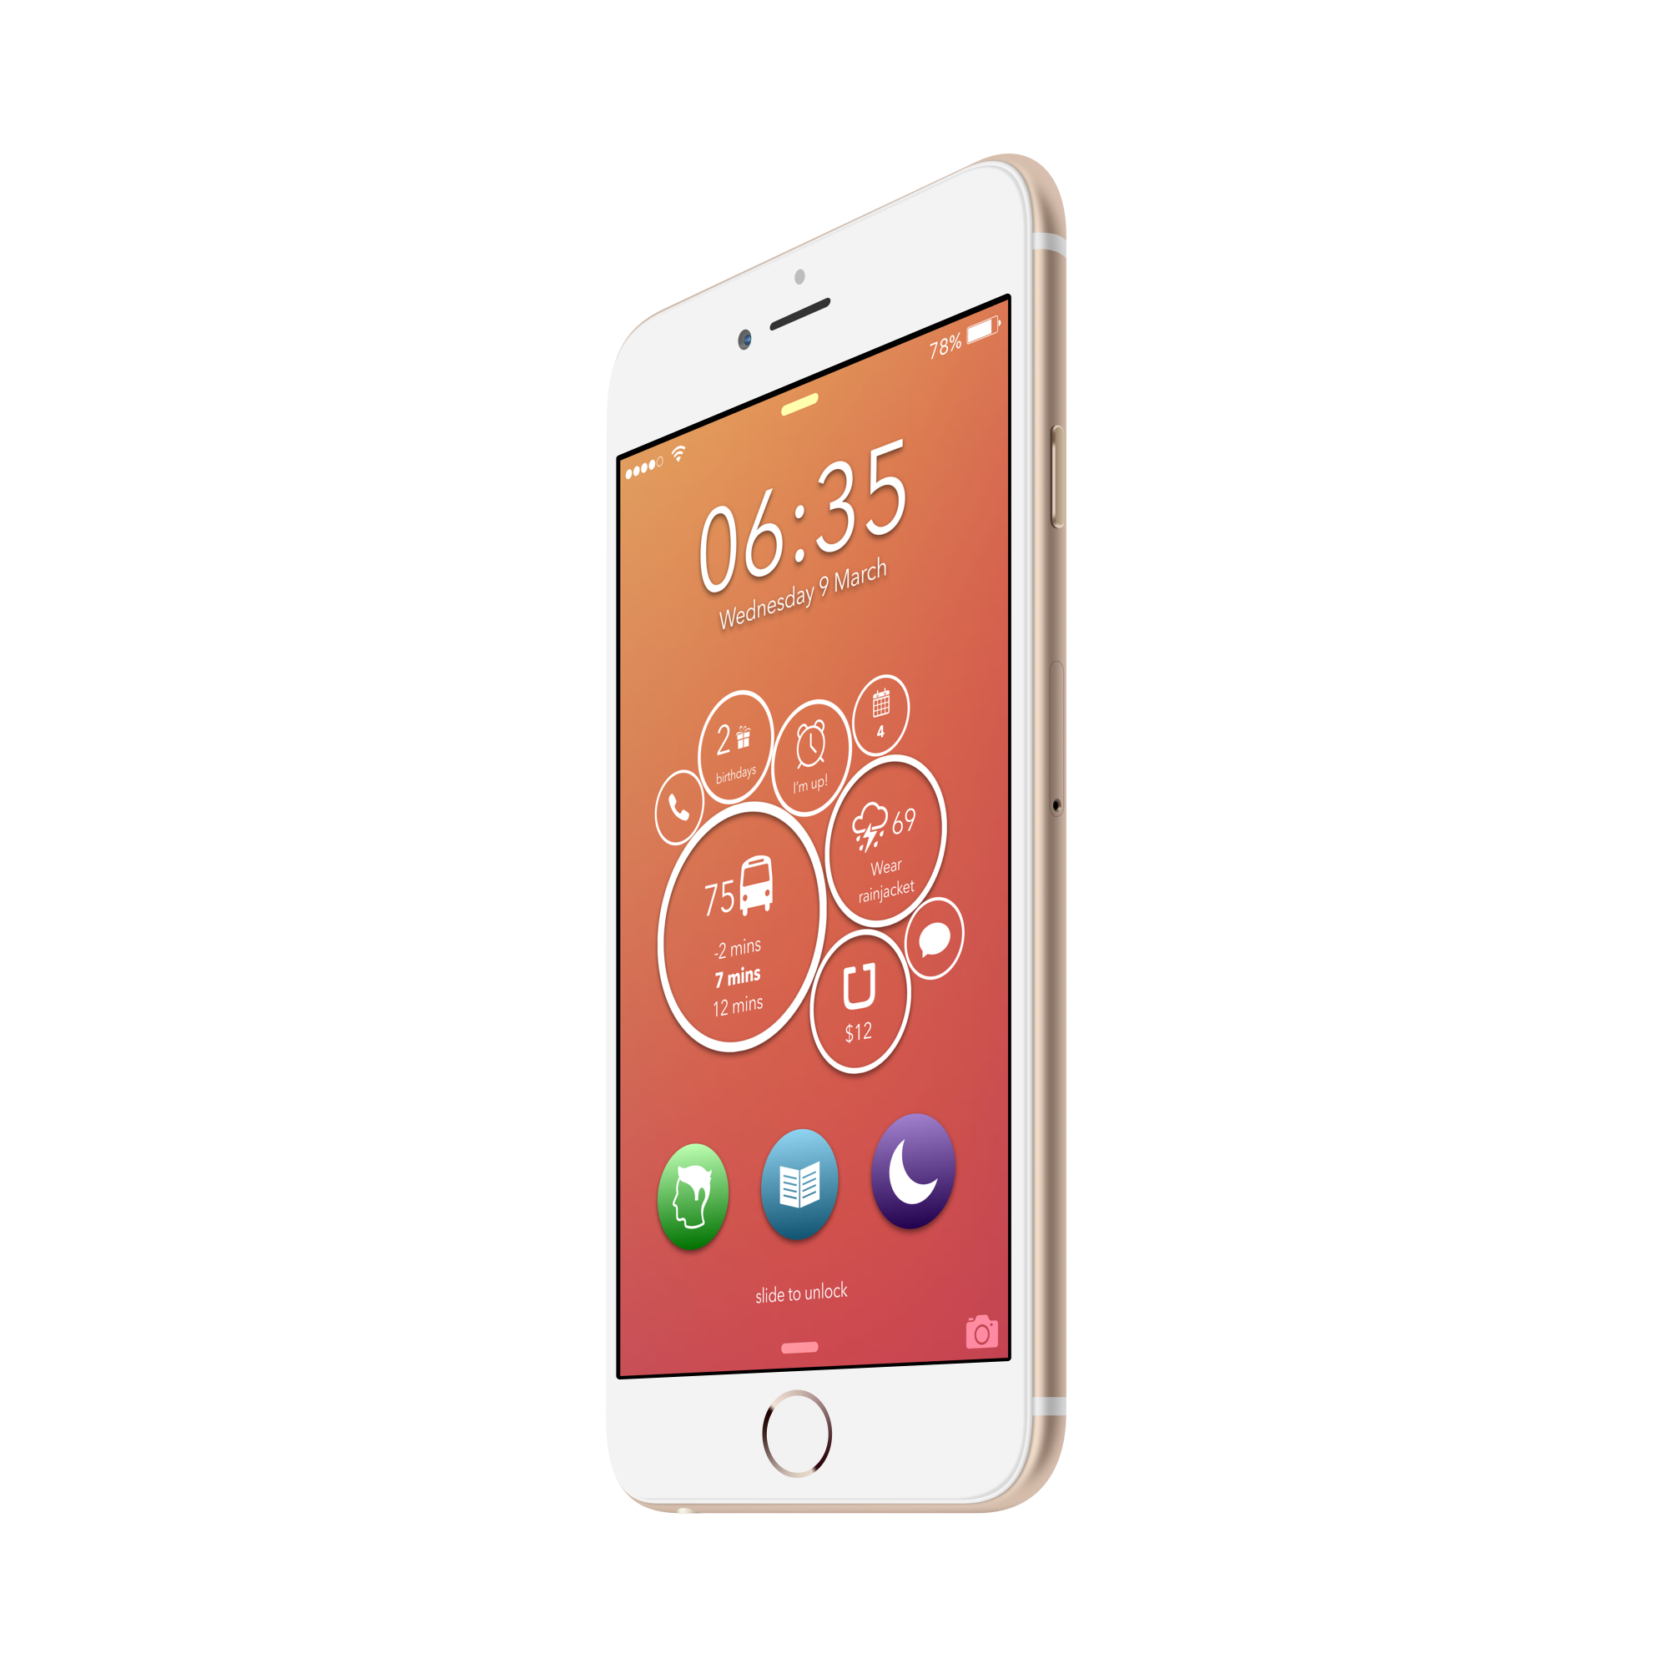
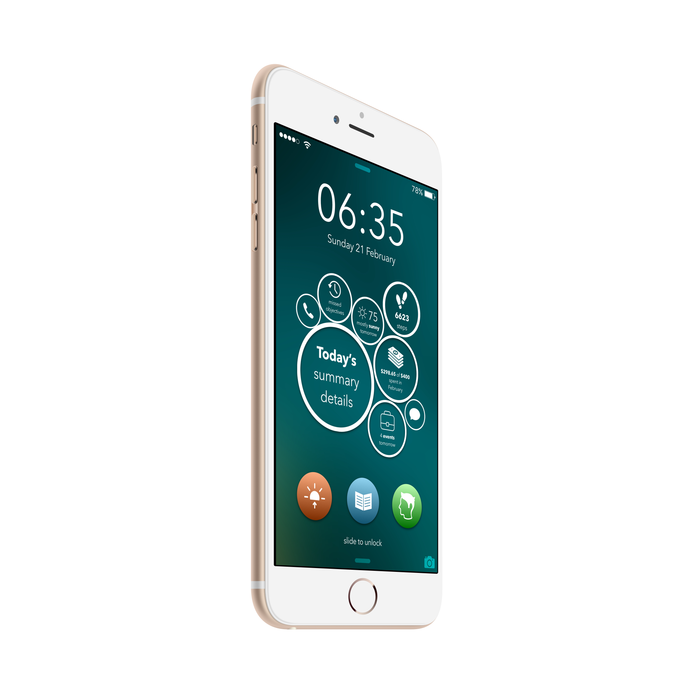
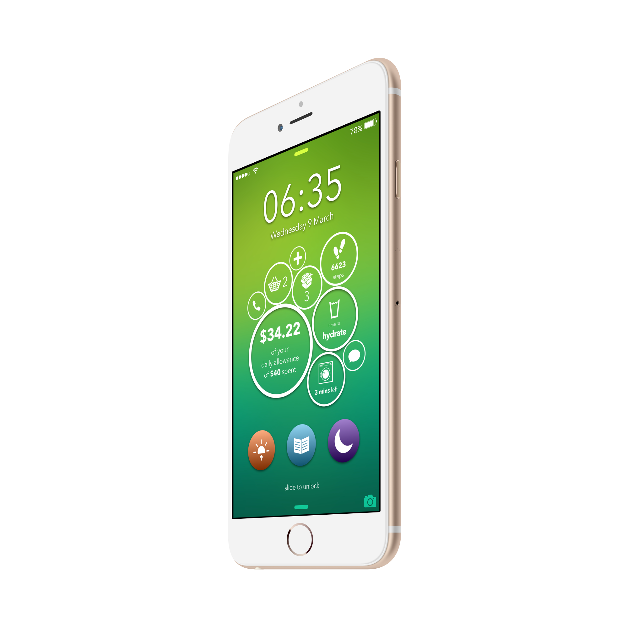
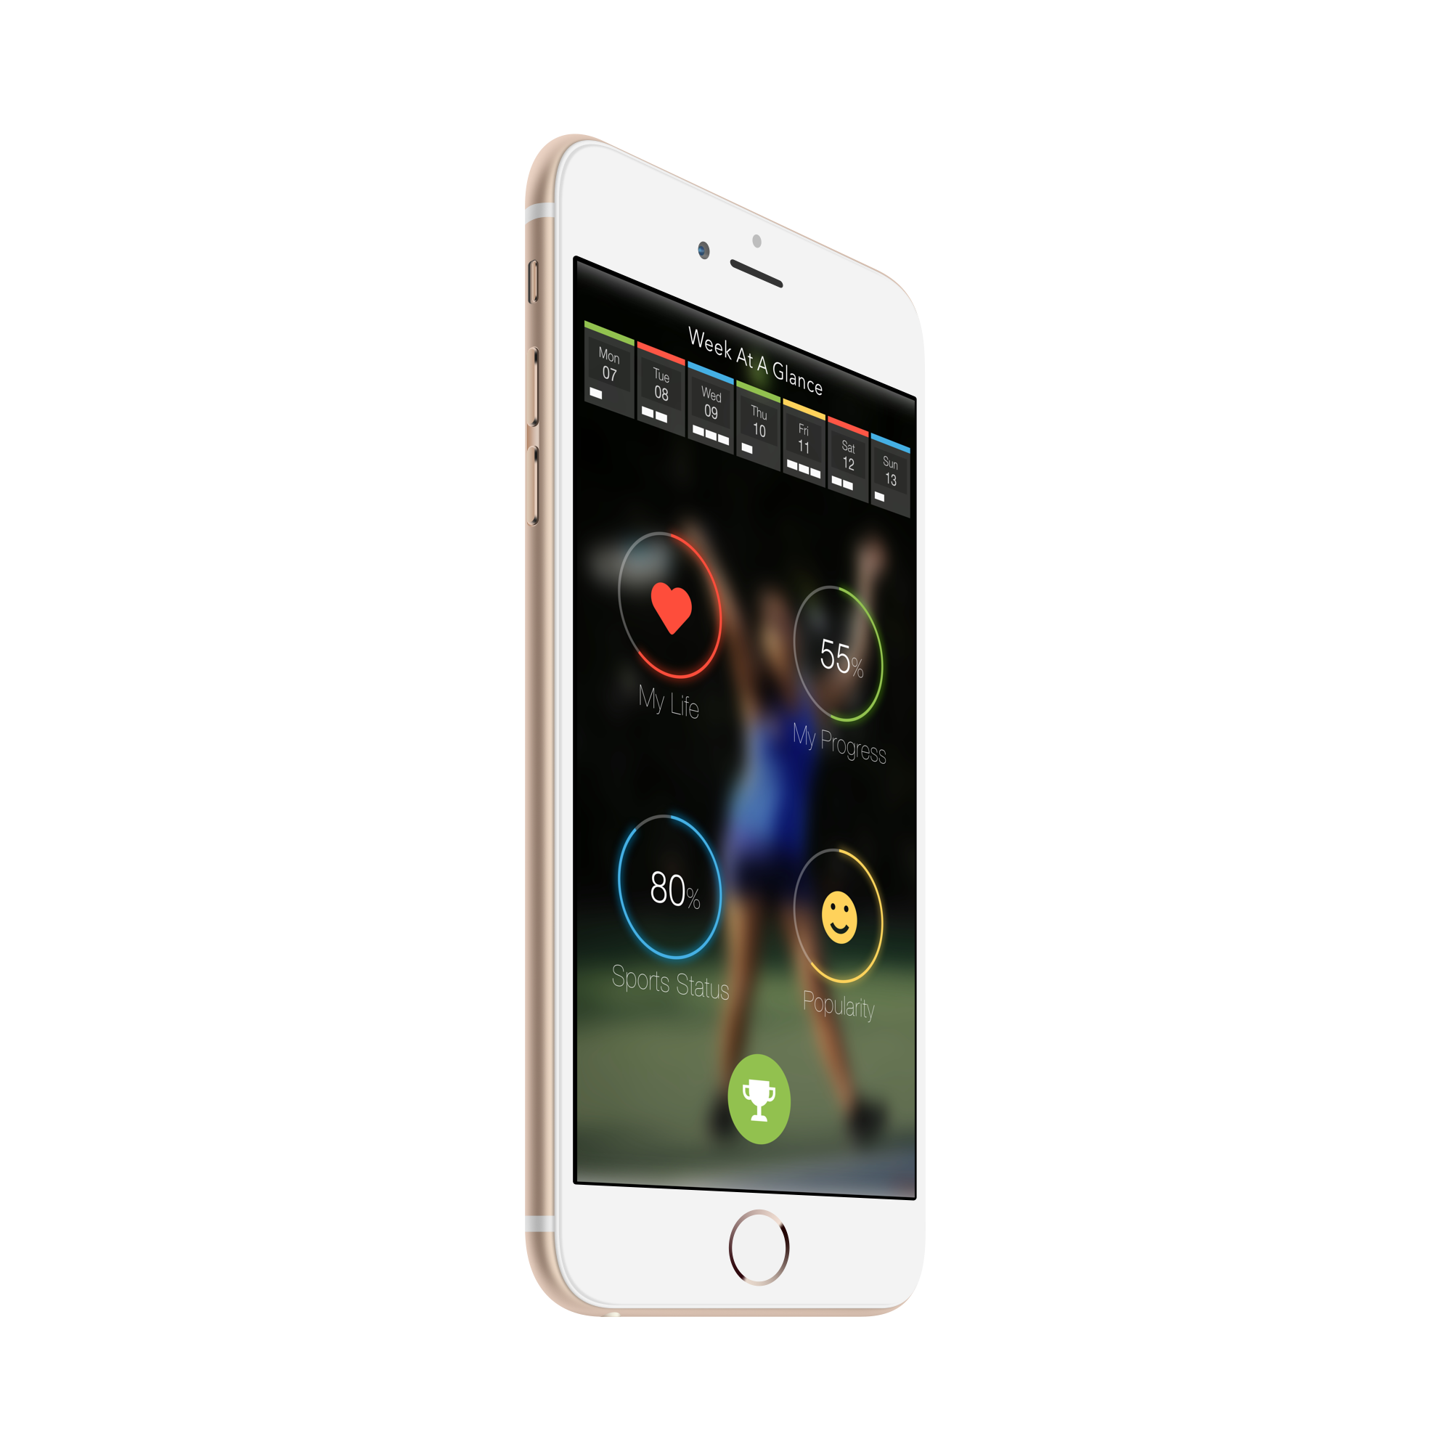
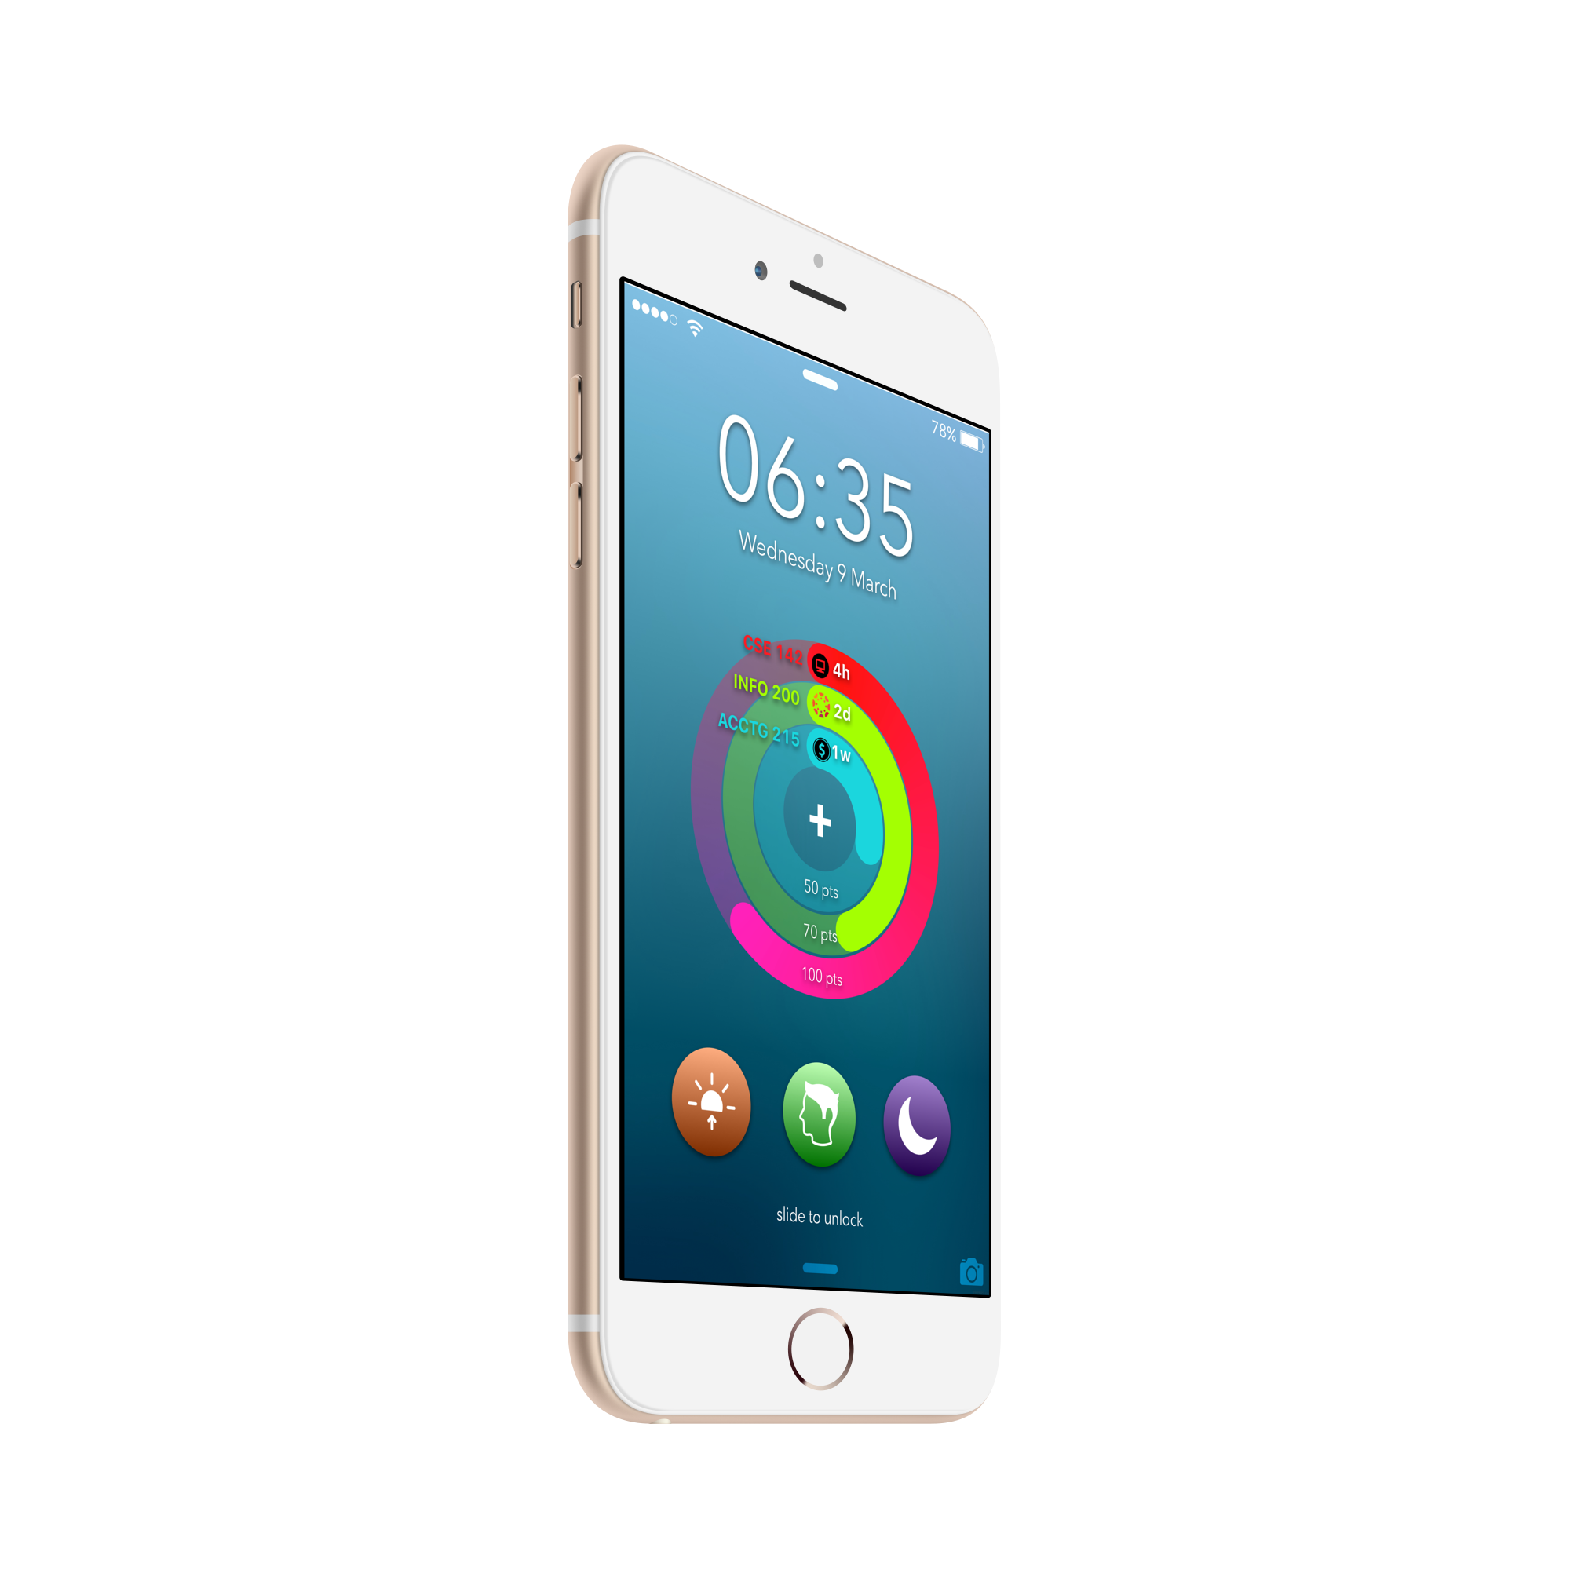
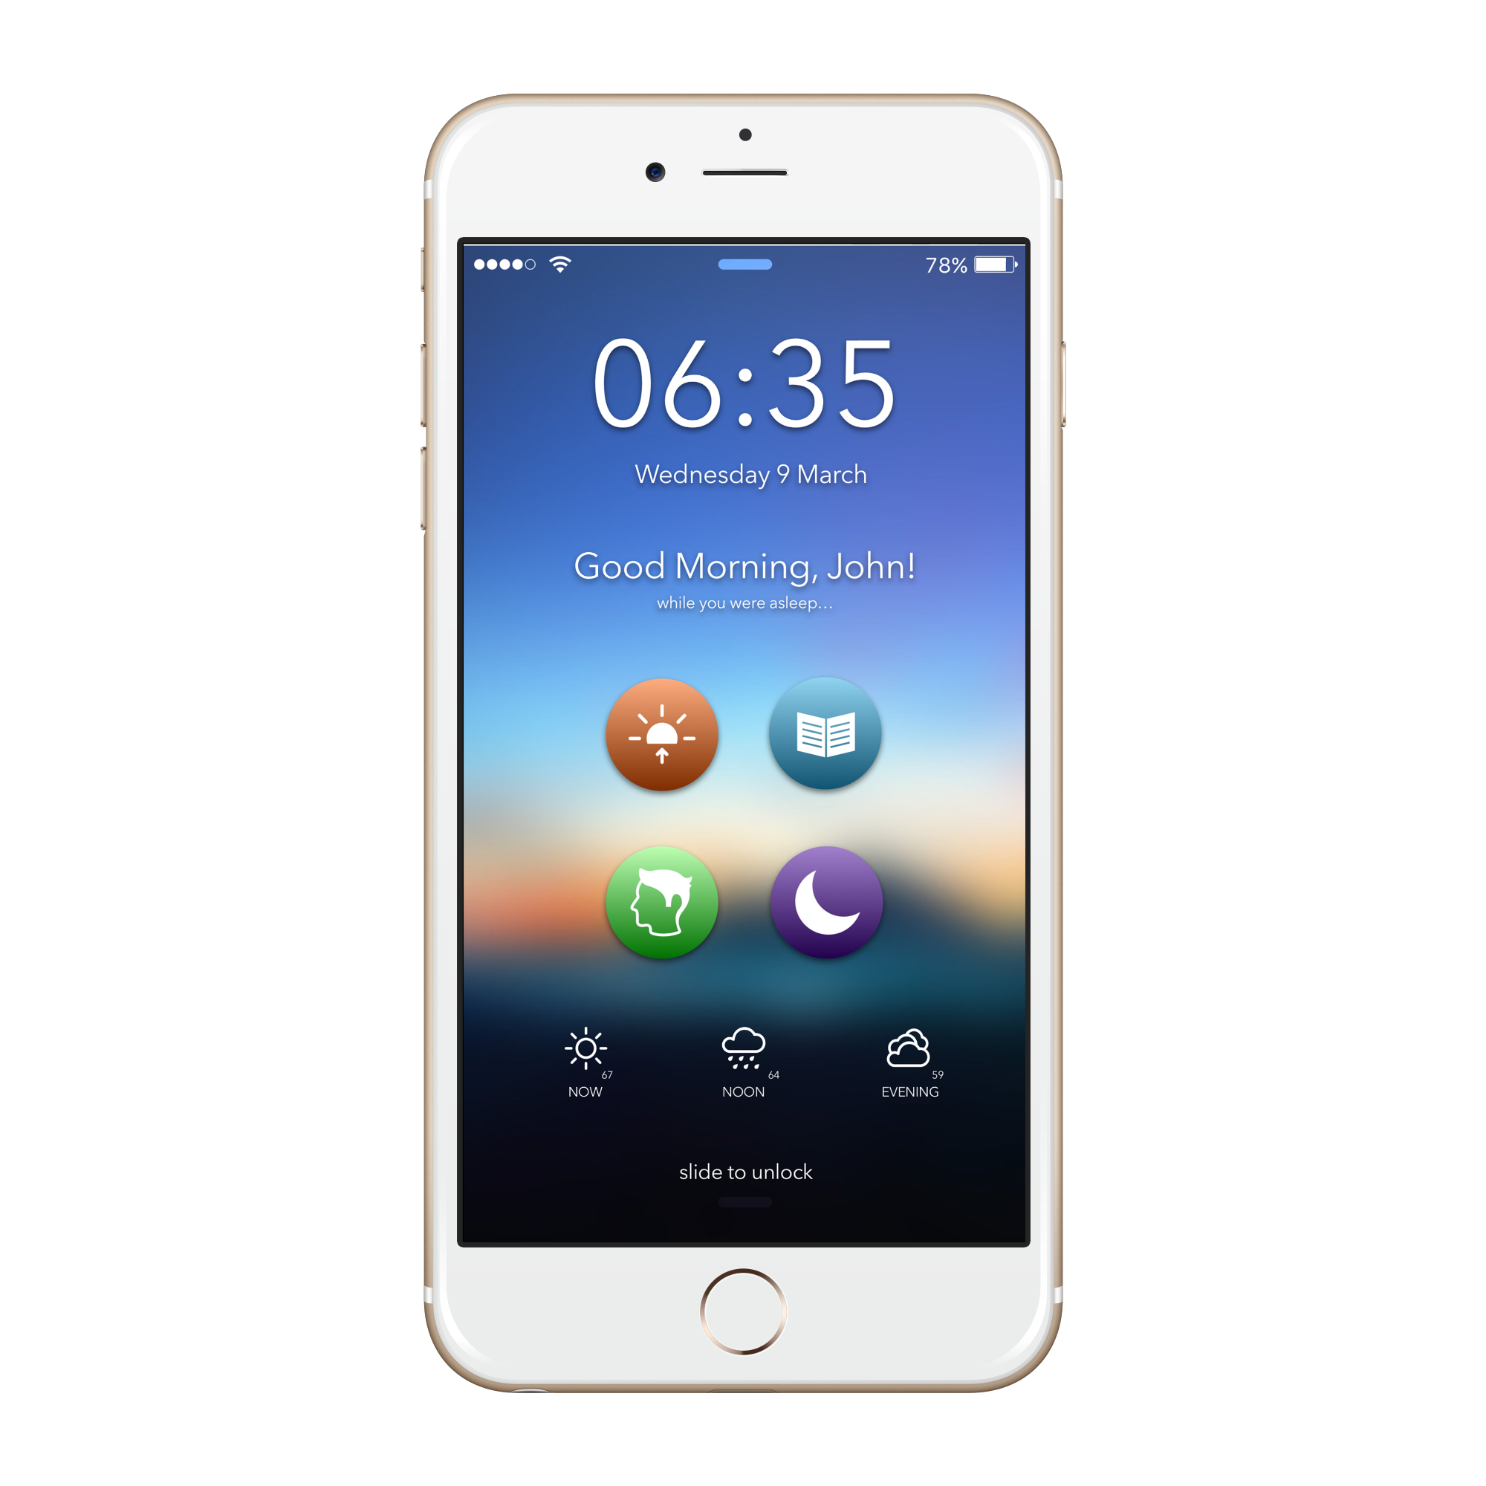

Slide 3
So easy to use, you already know how to use it.

Slide 4
4 MODES Morning / Personal / Study / Night

Slide 5
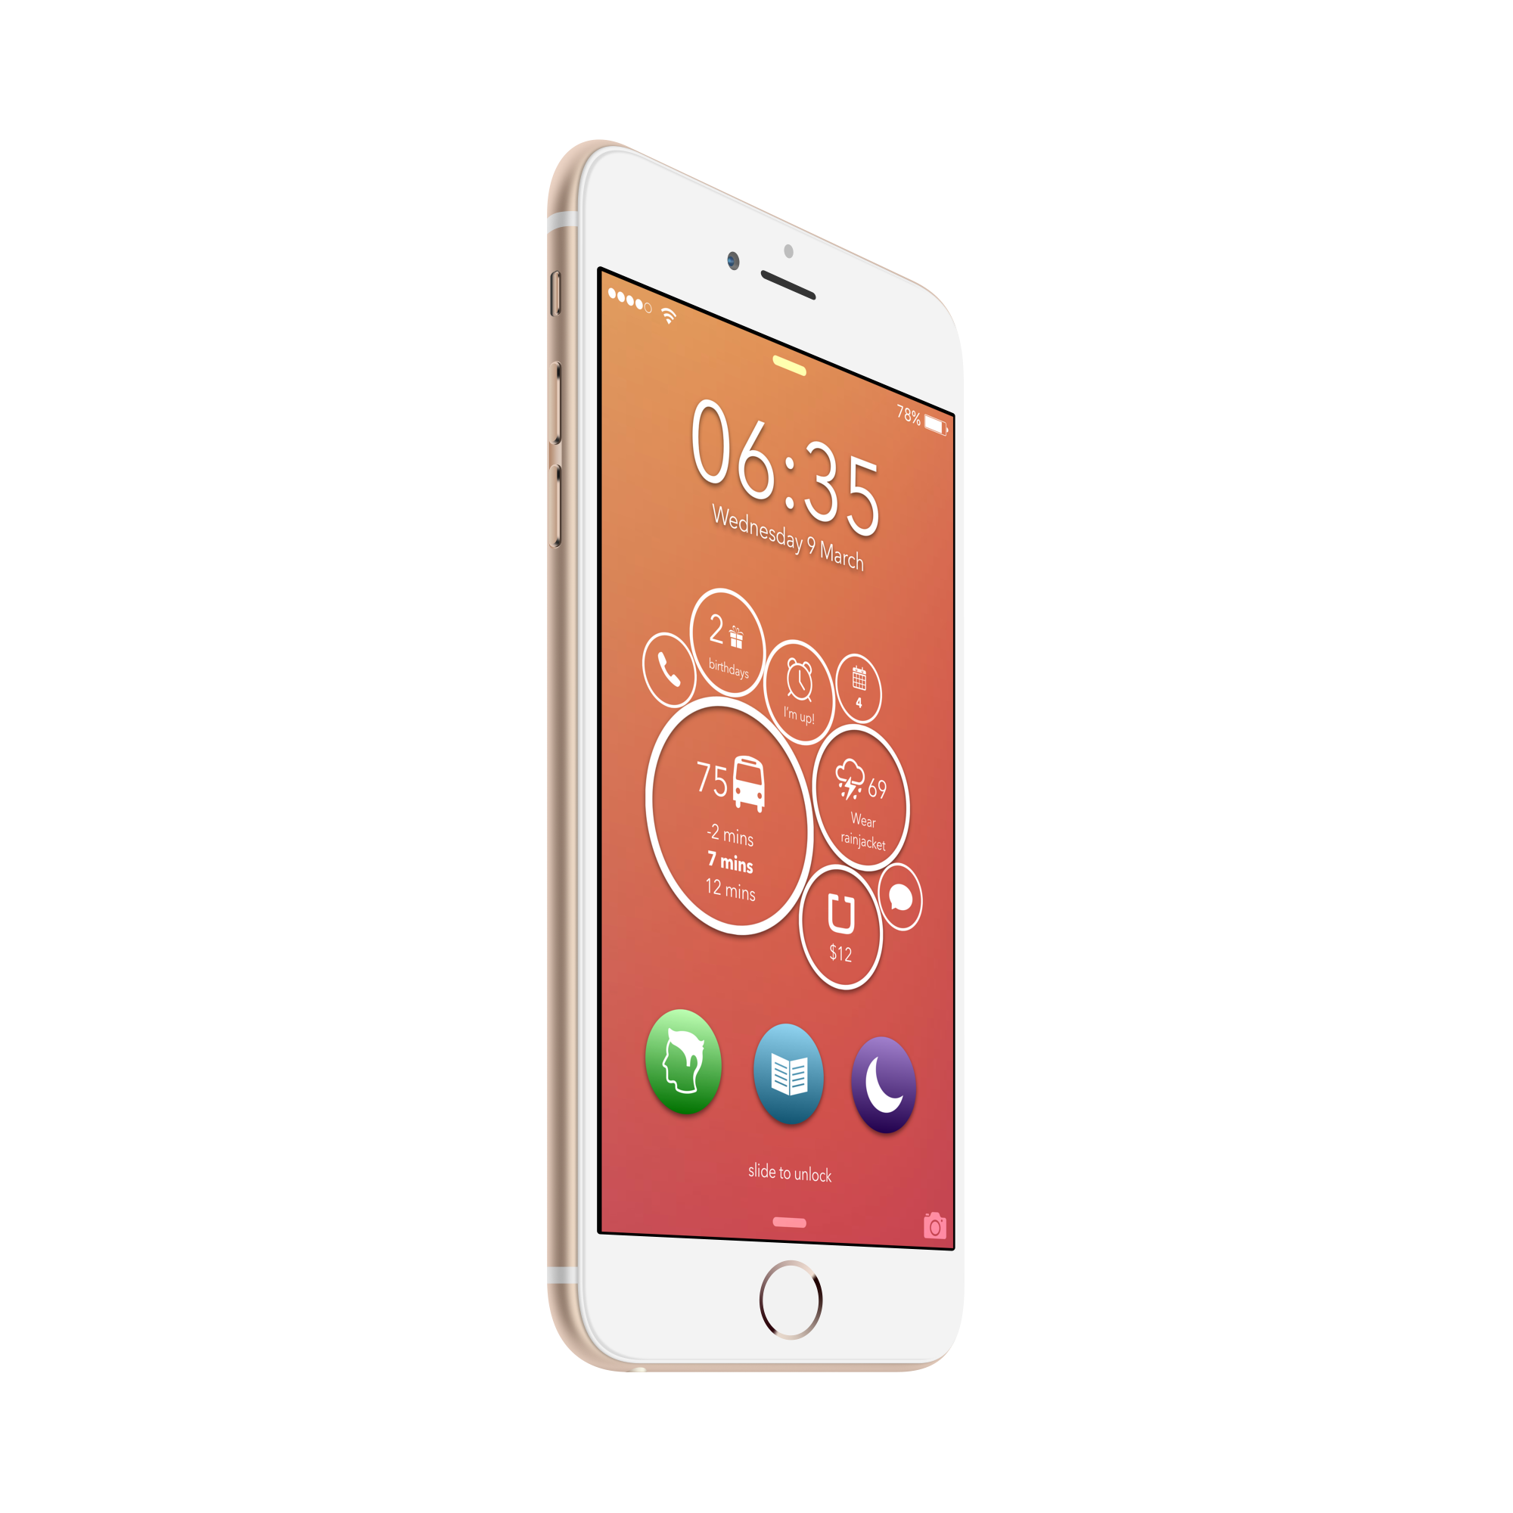
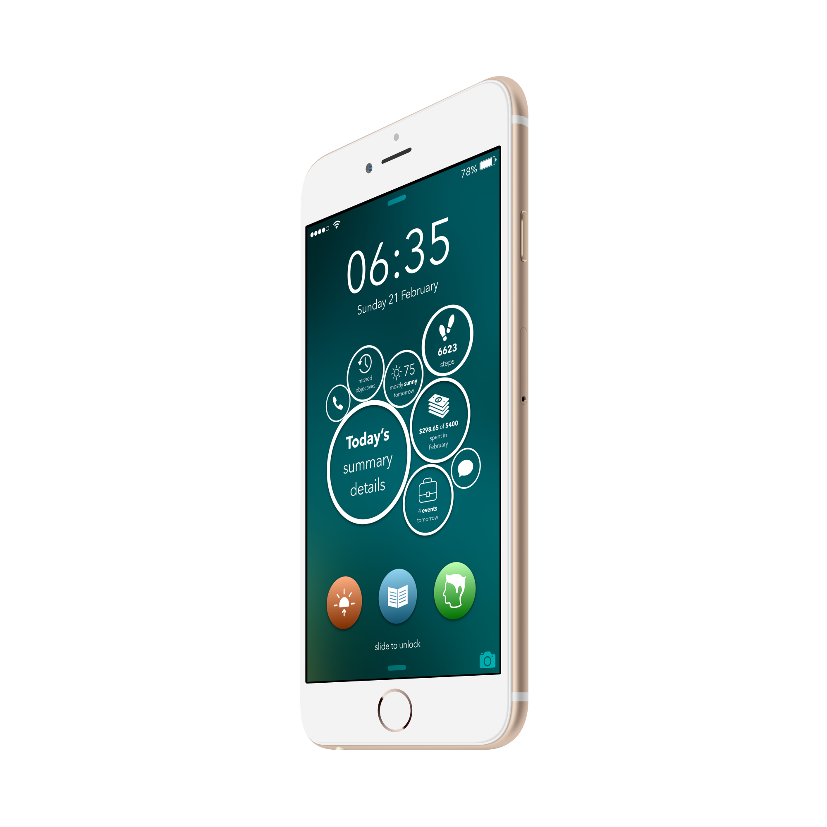
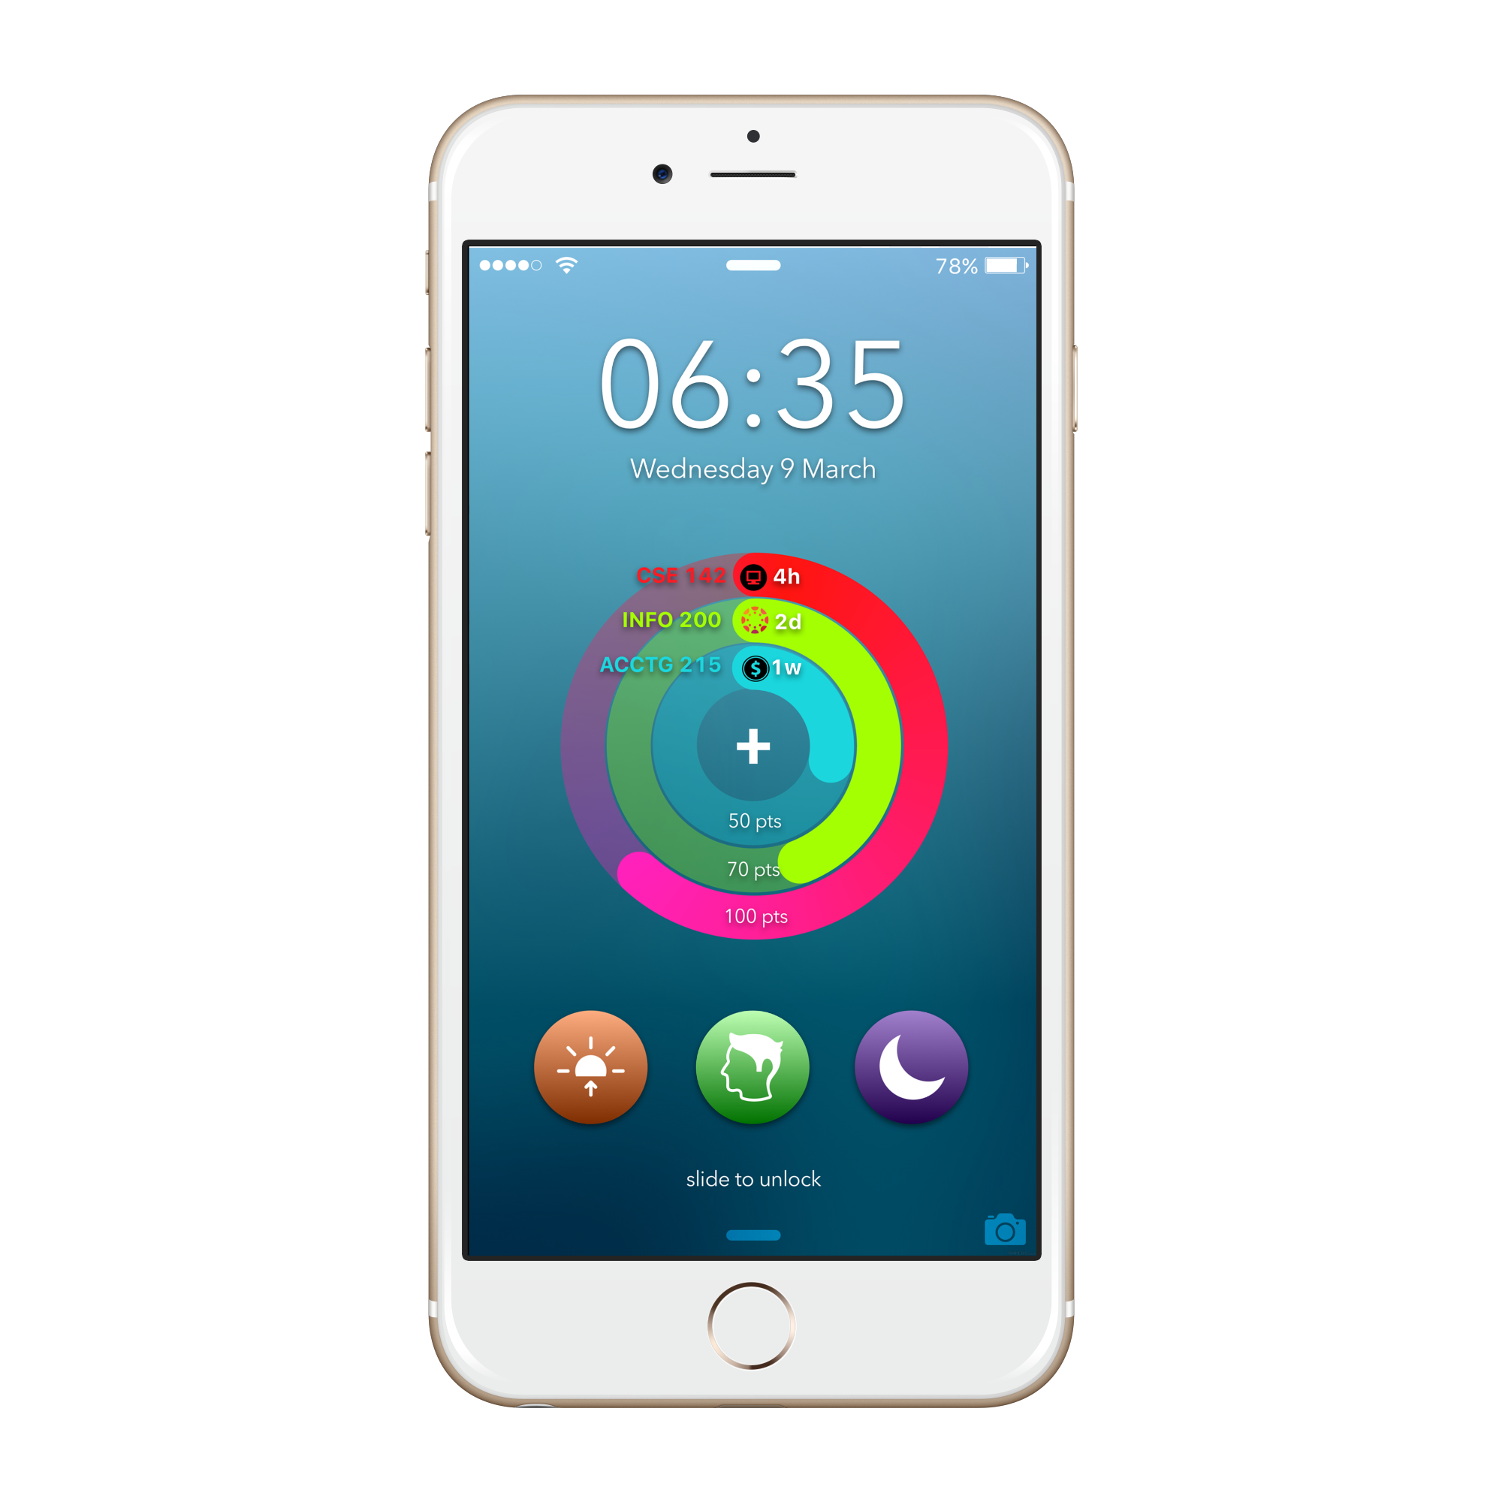

Slide 6
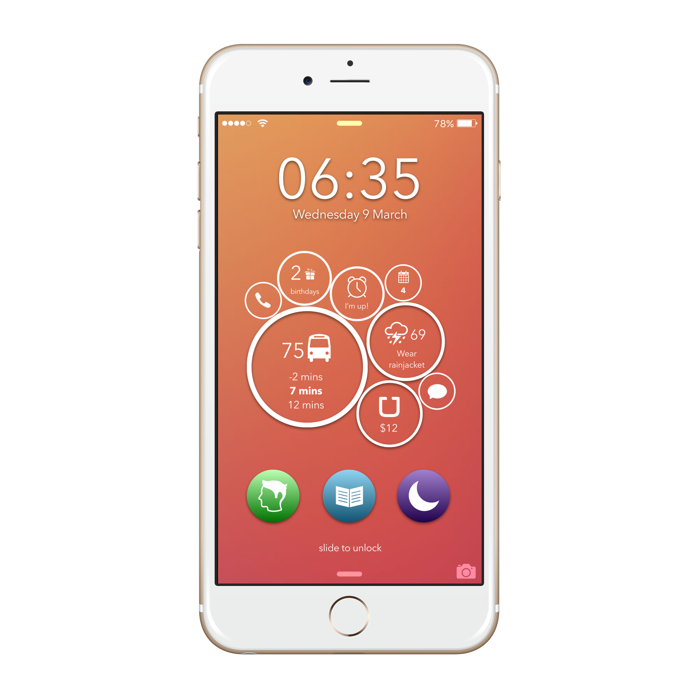
Morning Mode
All the information, right on your fingertip.
Never Miss The Bus Again.
Be Prepared.
Never Miss An Event.
All from your lockscreen.

Slide 7
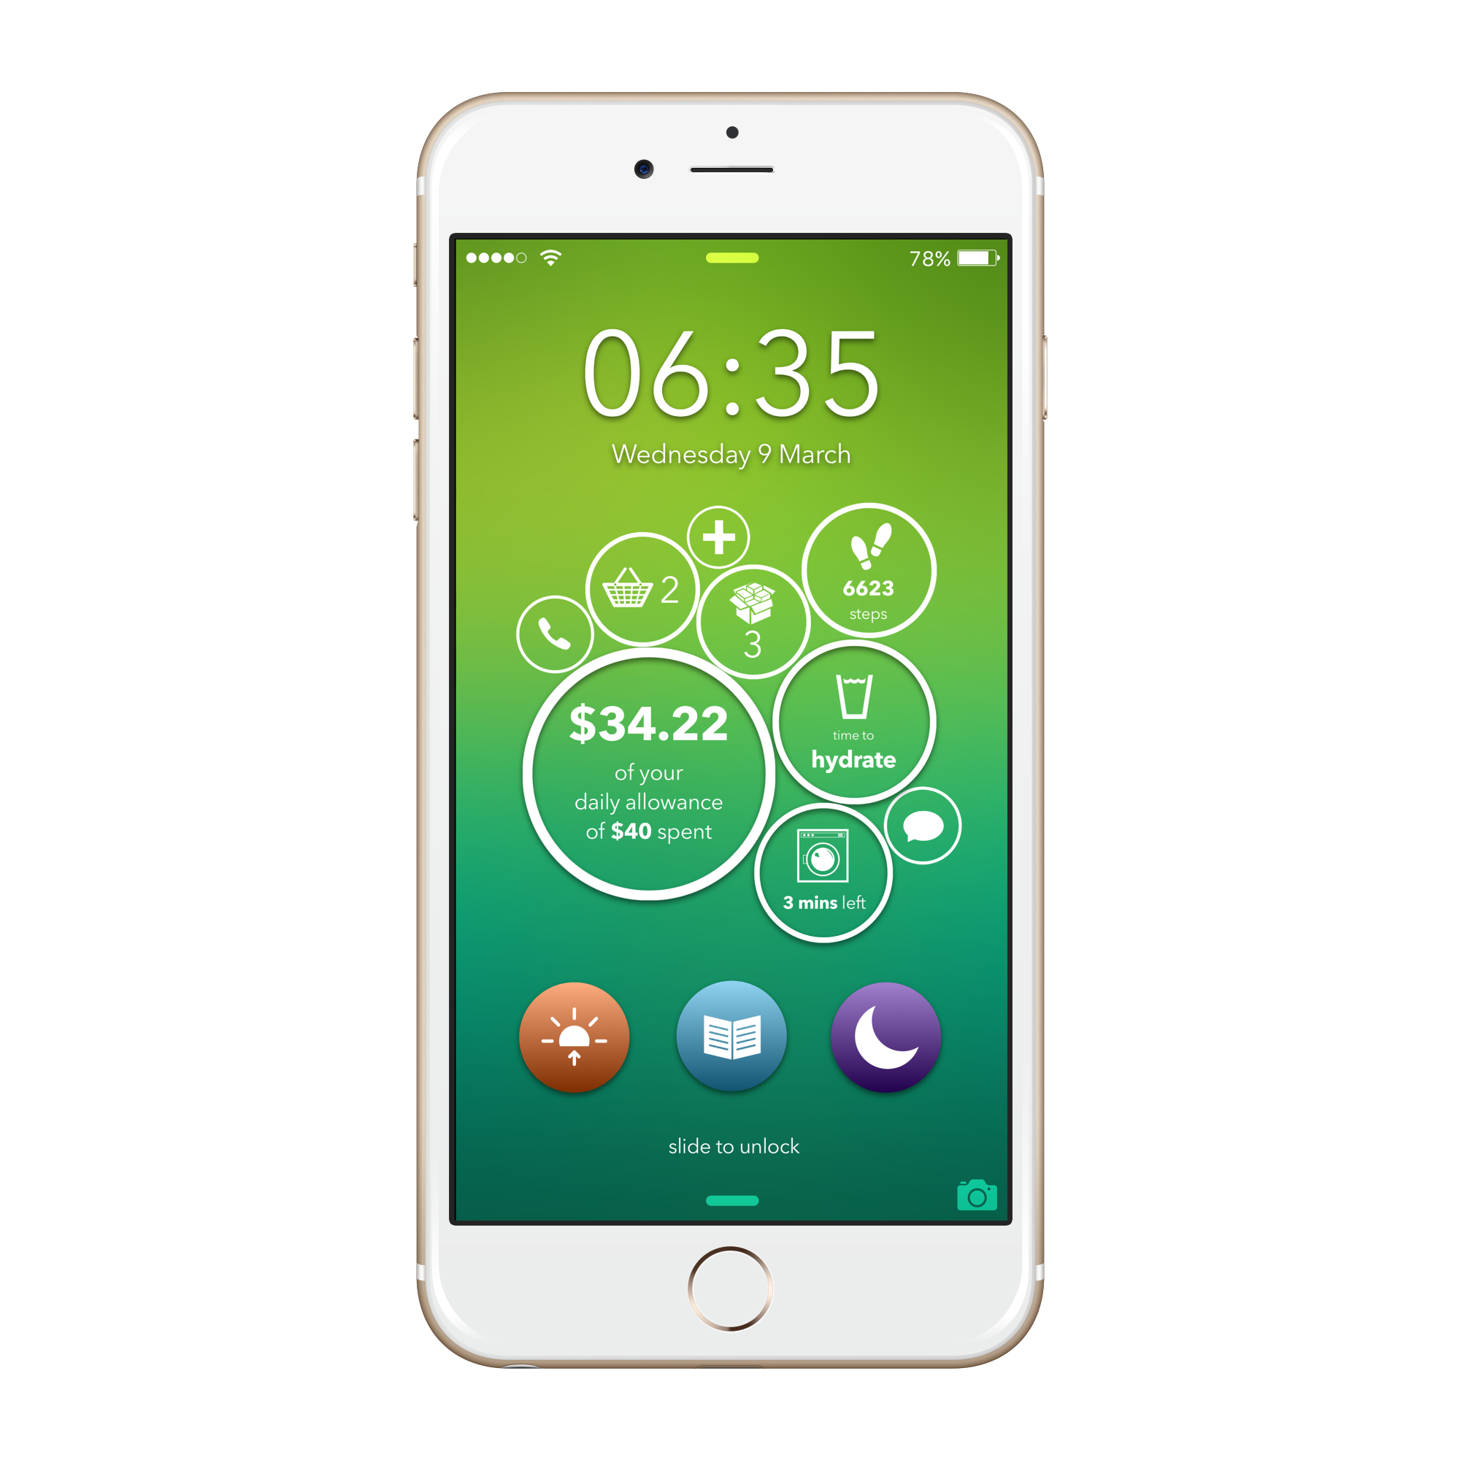
Personal Mode
Monitor Health On The Go.
Keep Track of ‘To-do’s.
Track Packages.
Manage Your Money.
All from your lockscreen.

Slide 8
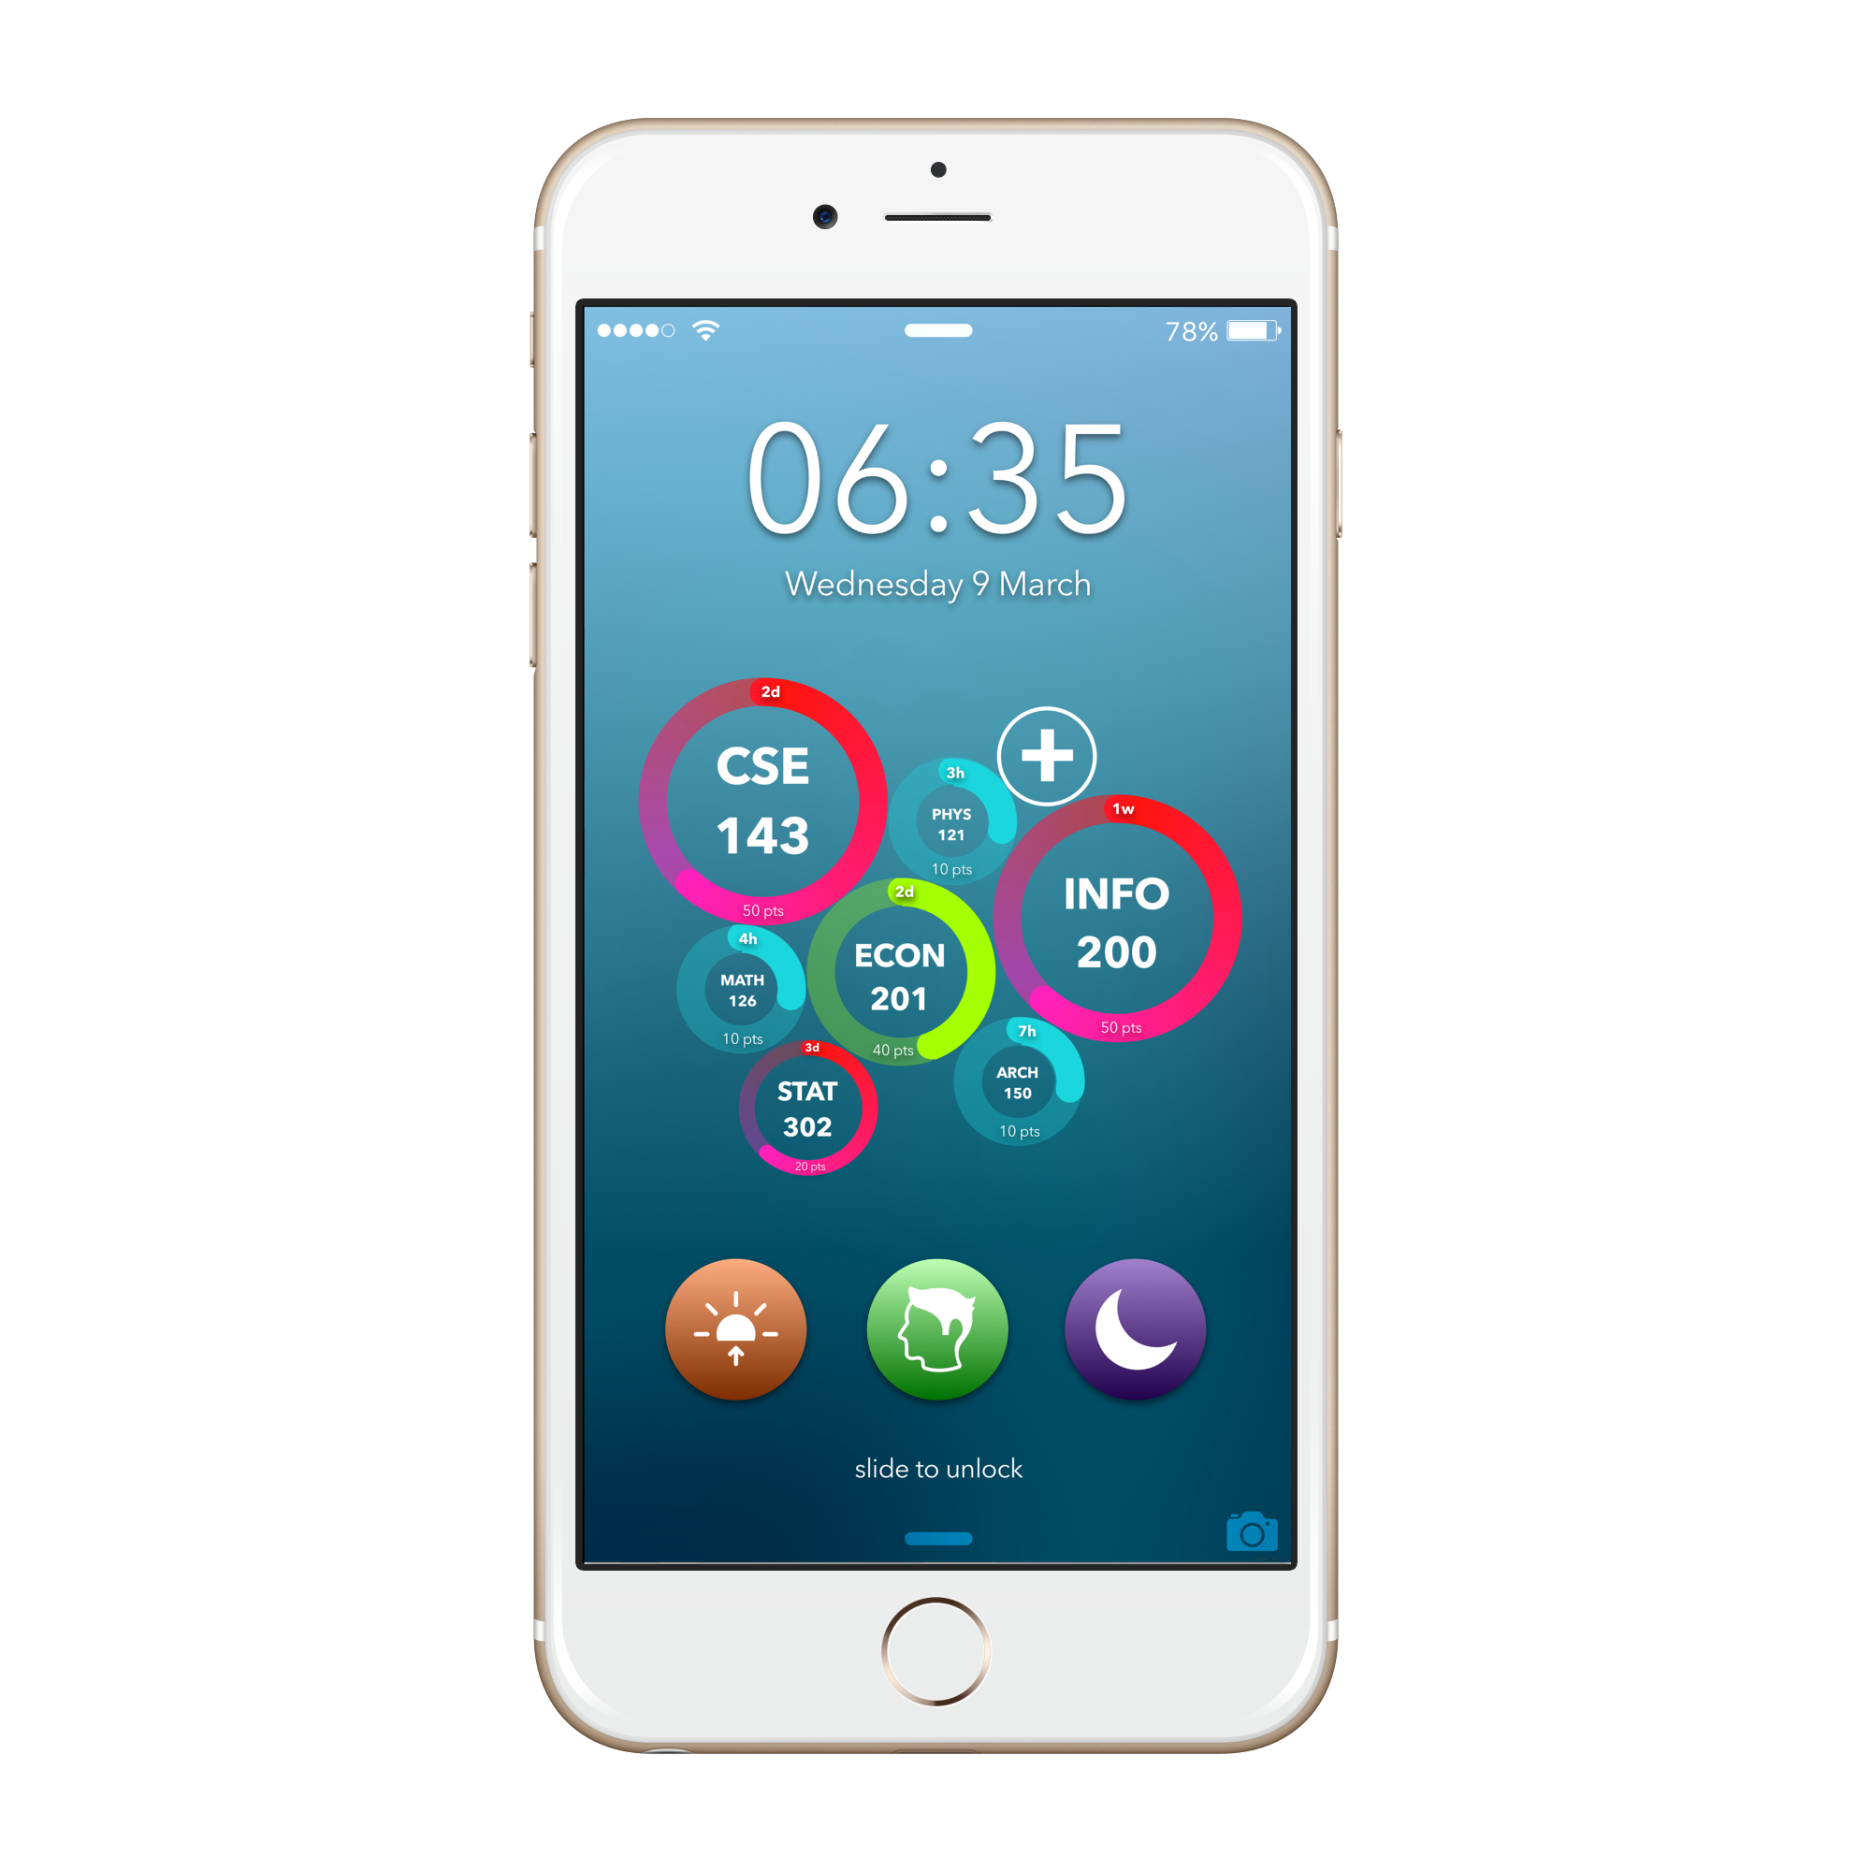
Study Mode
Keep Track of Assignments.
Monitor Progress in All Classes
Earn Points, Redeem.
Productivity Made Addictive.
All from your lockscreen.

Slide 9
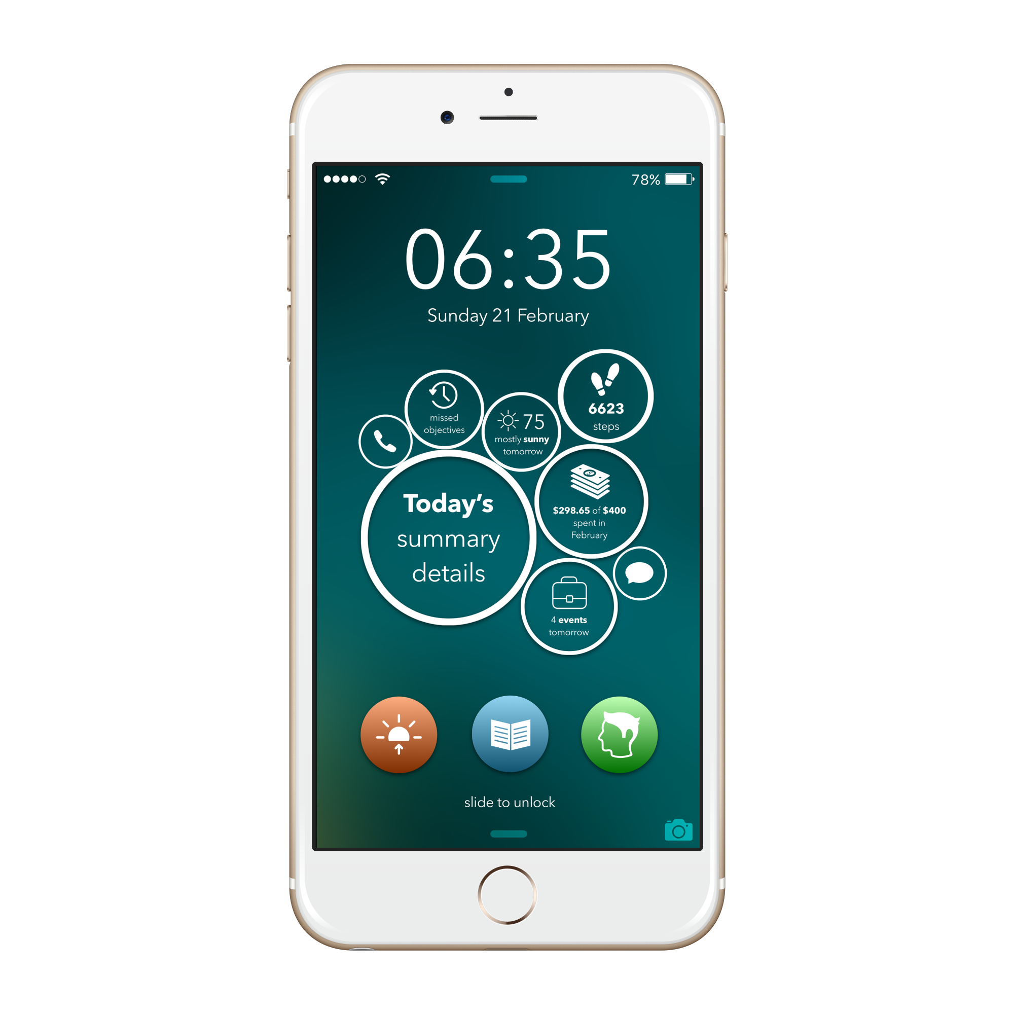
Night Mode
Be Prepared for Tomorrow, Before Tomorrow.
Never Miss an Event Again.
Track Your Spending Each Day.
Stay Connected.
All from your lockscreen.

Slide 10
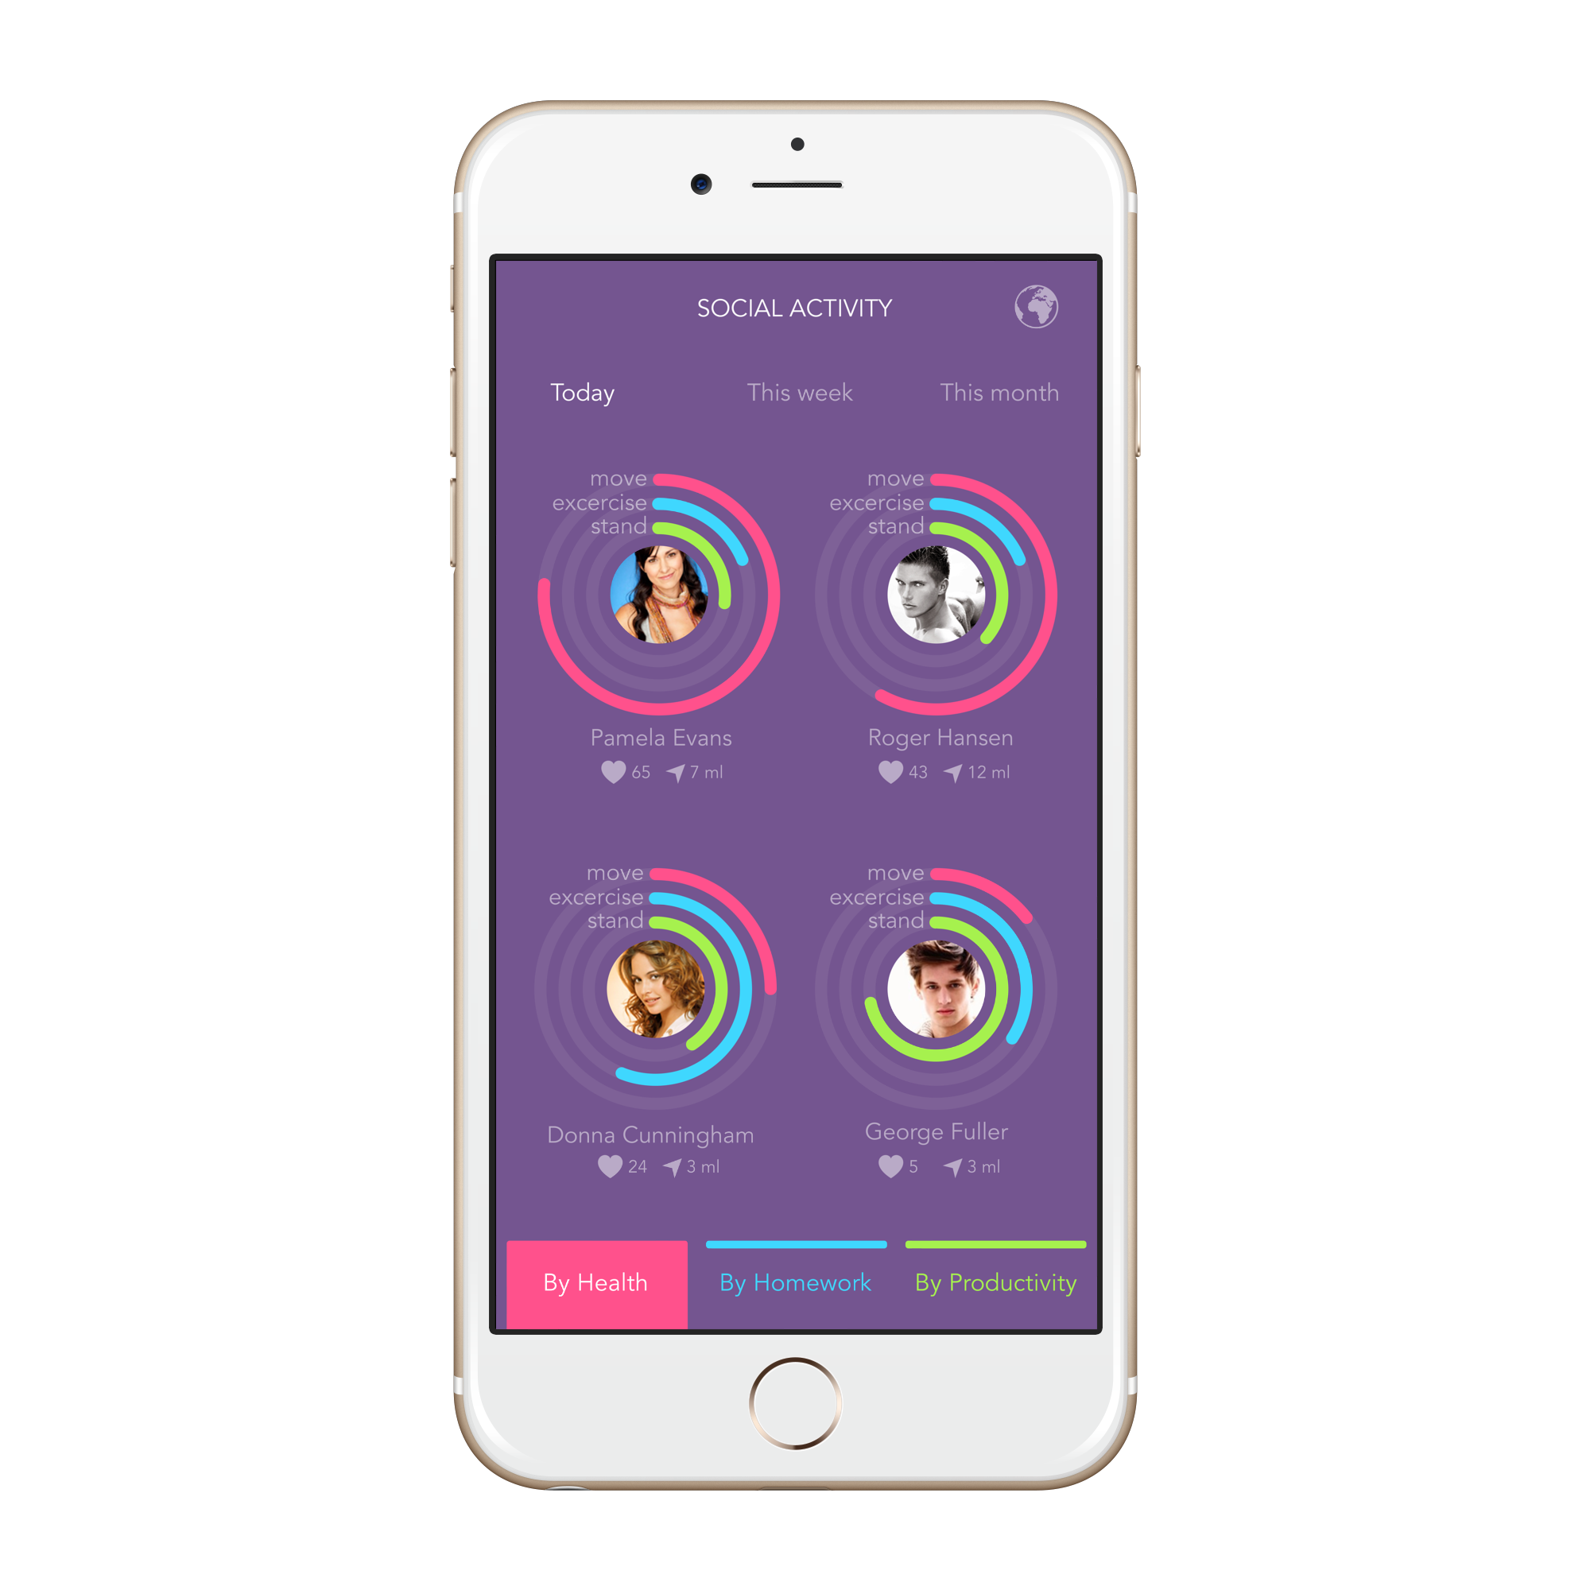
Daily Summaries
View Progress of Your Closest Friends
Make Productivity Addictive

Slide 11
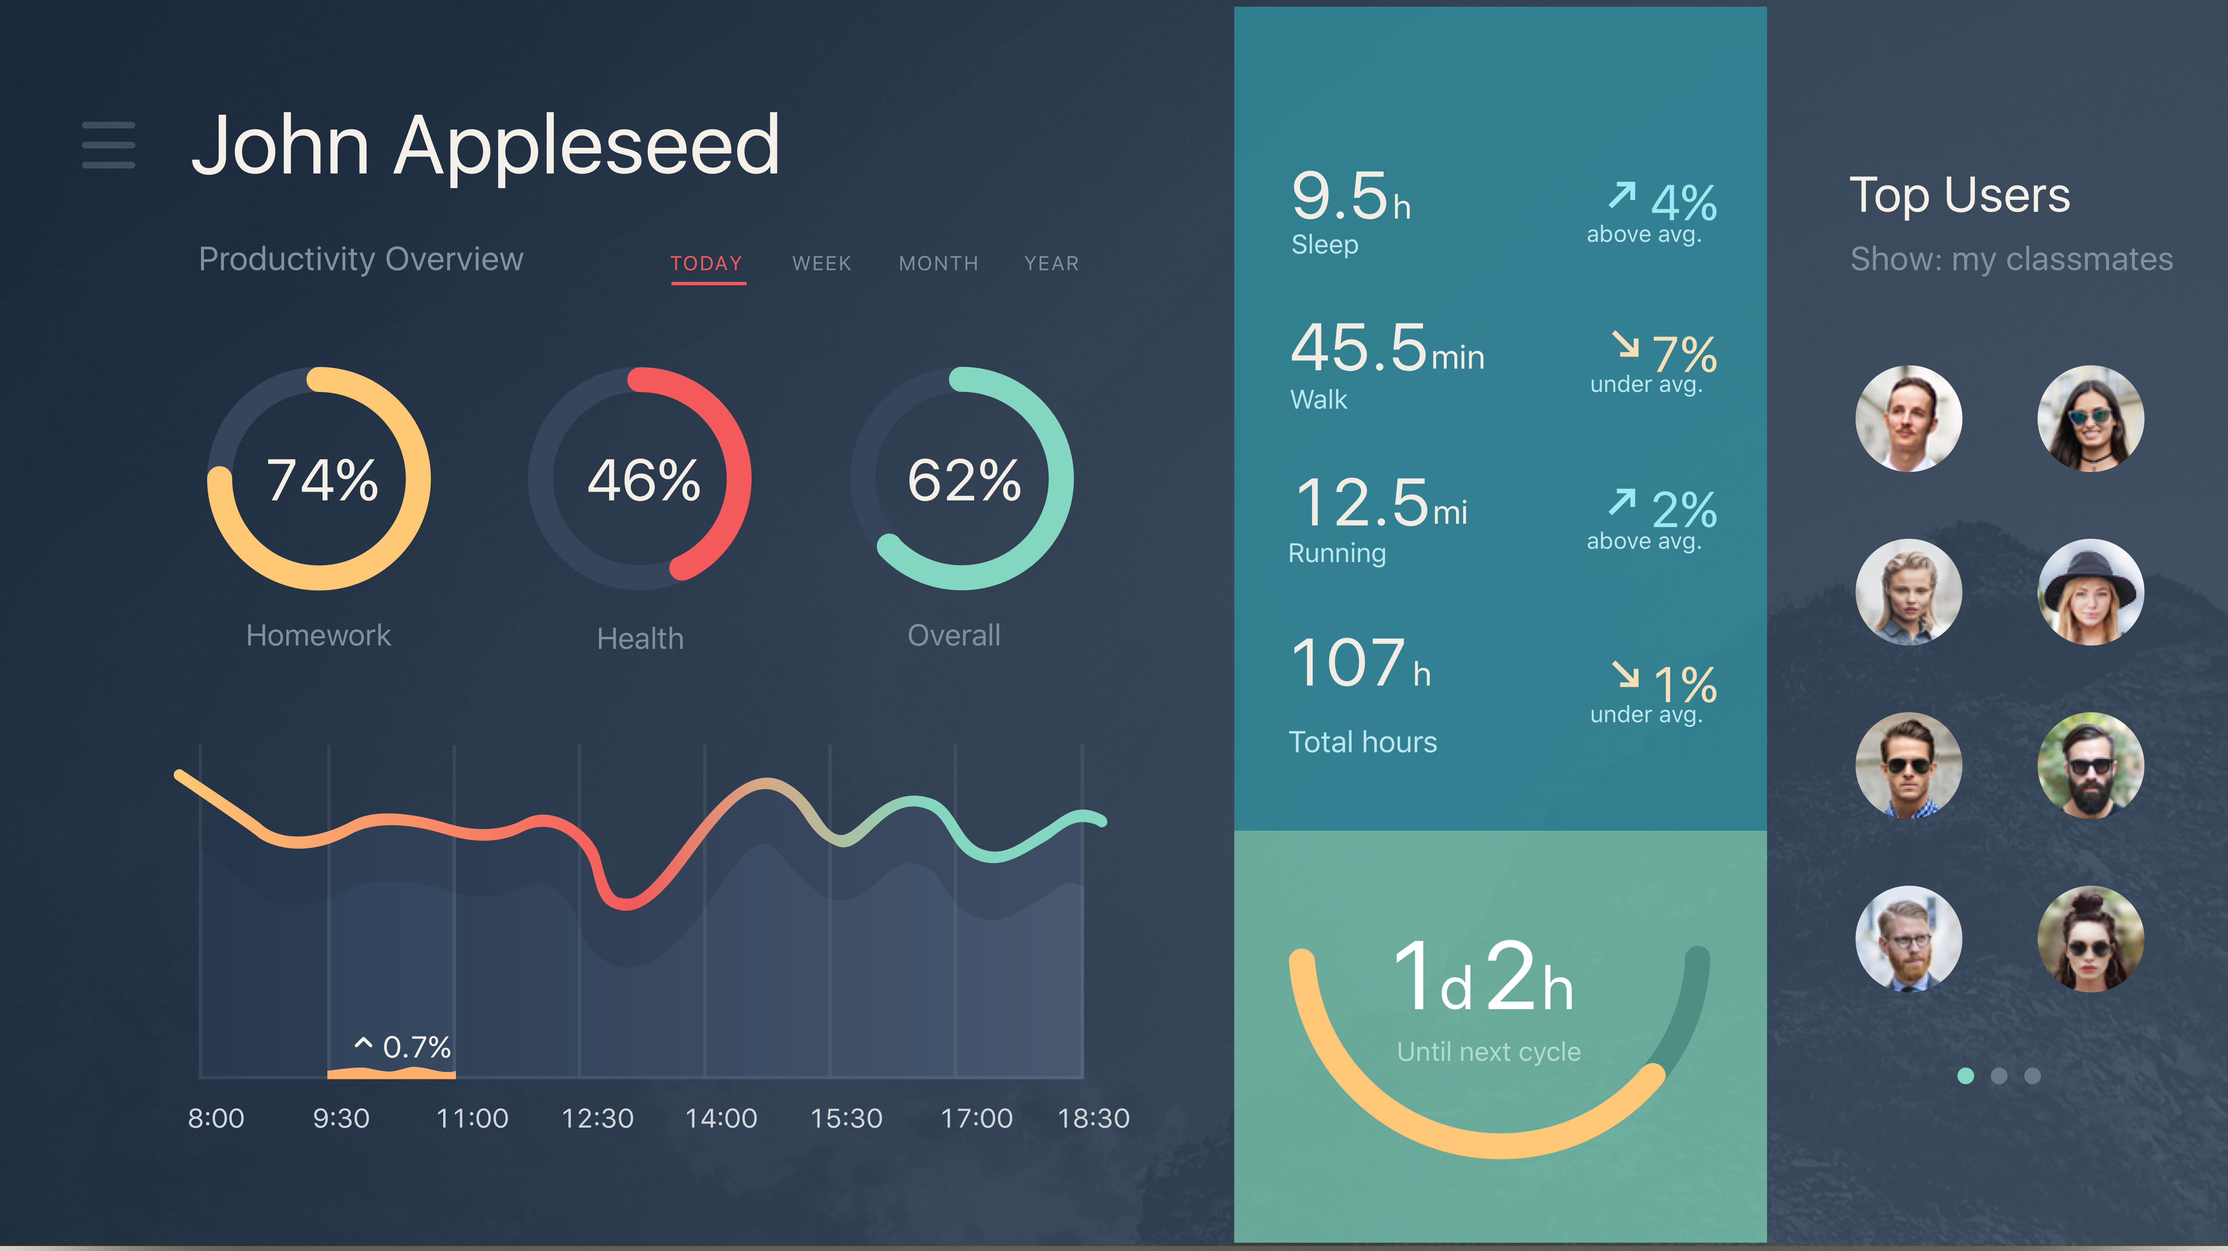
Weekly Leaderboards
View Progress of Your Entire Institution
Competition for a productive lifestyle

Slide 13
SECURE
Biometrics
6 Digit
Passcode Combination

Slide 14
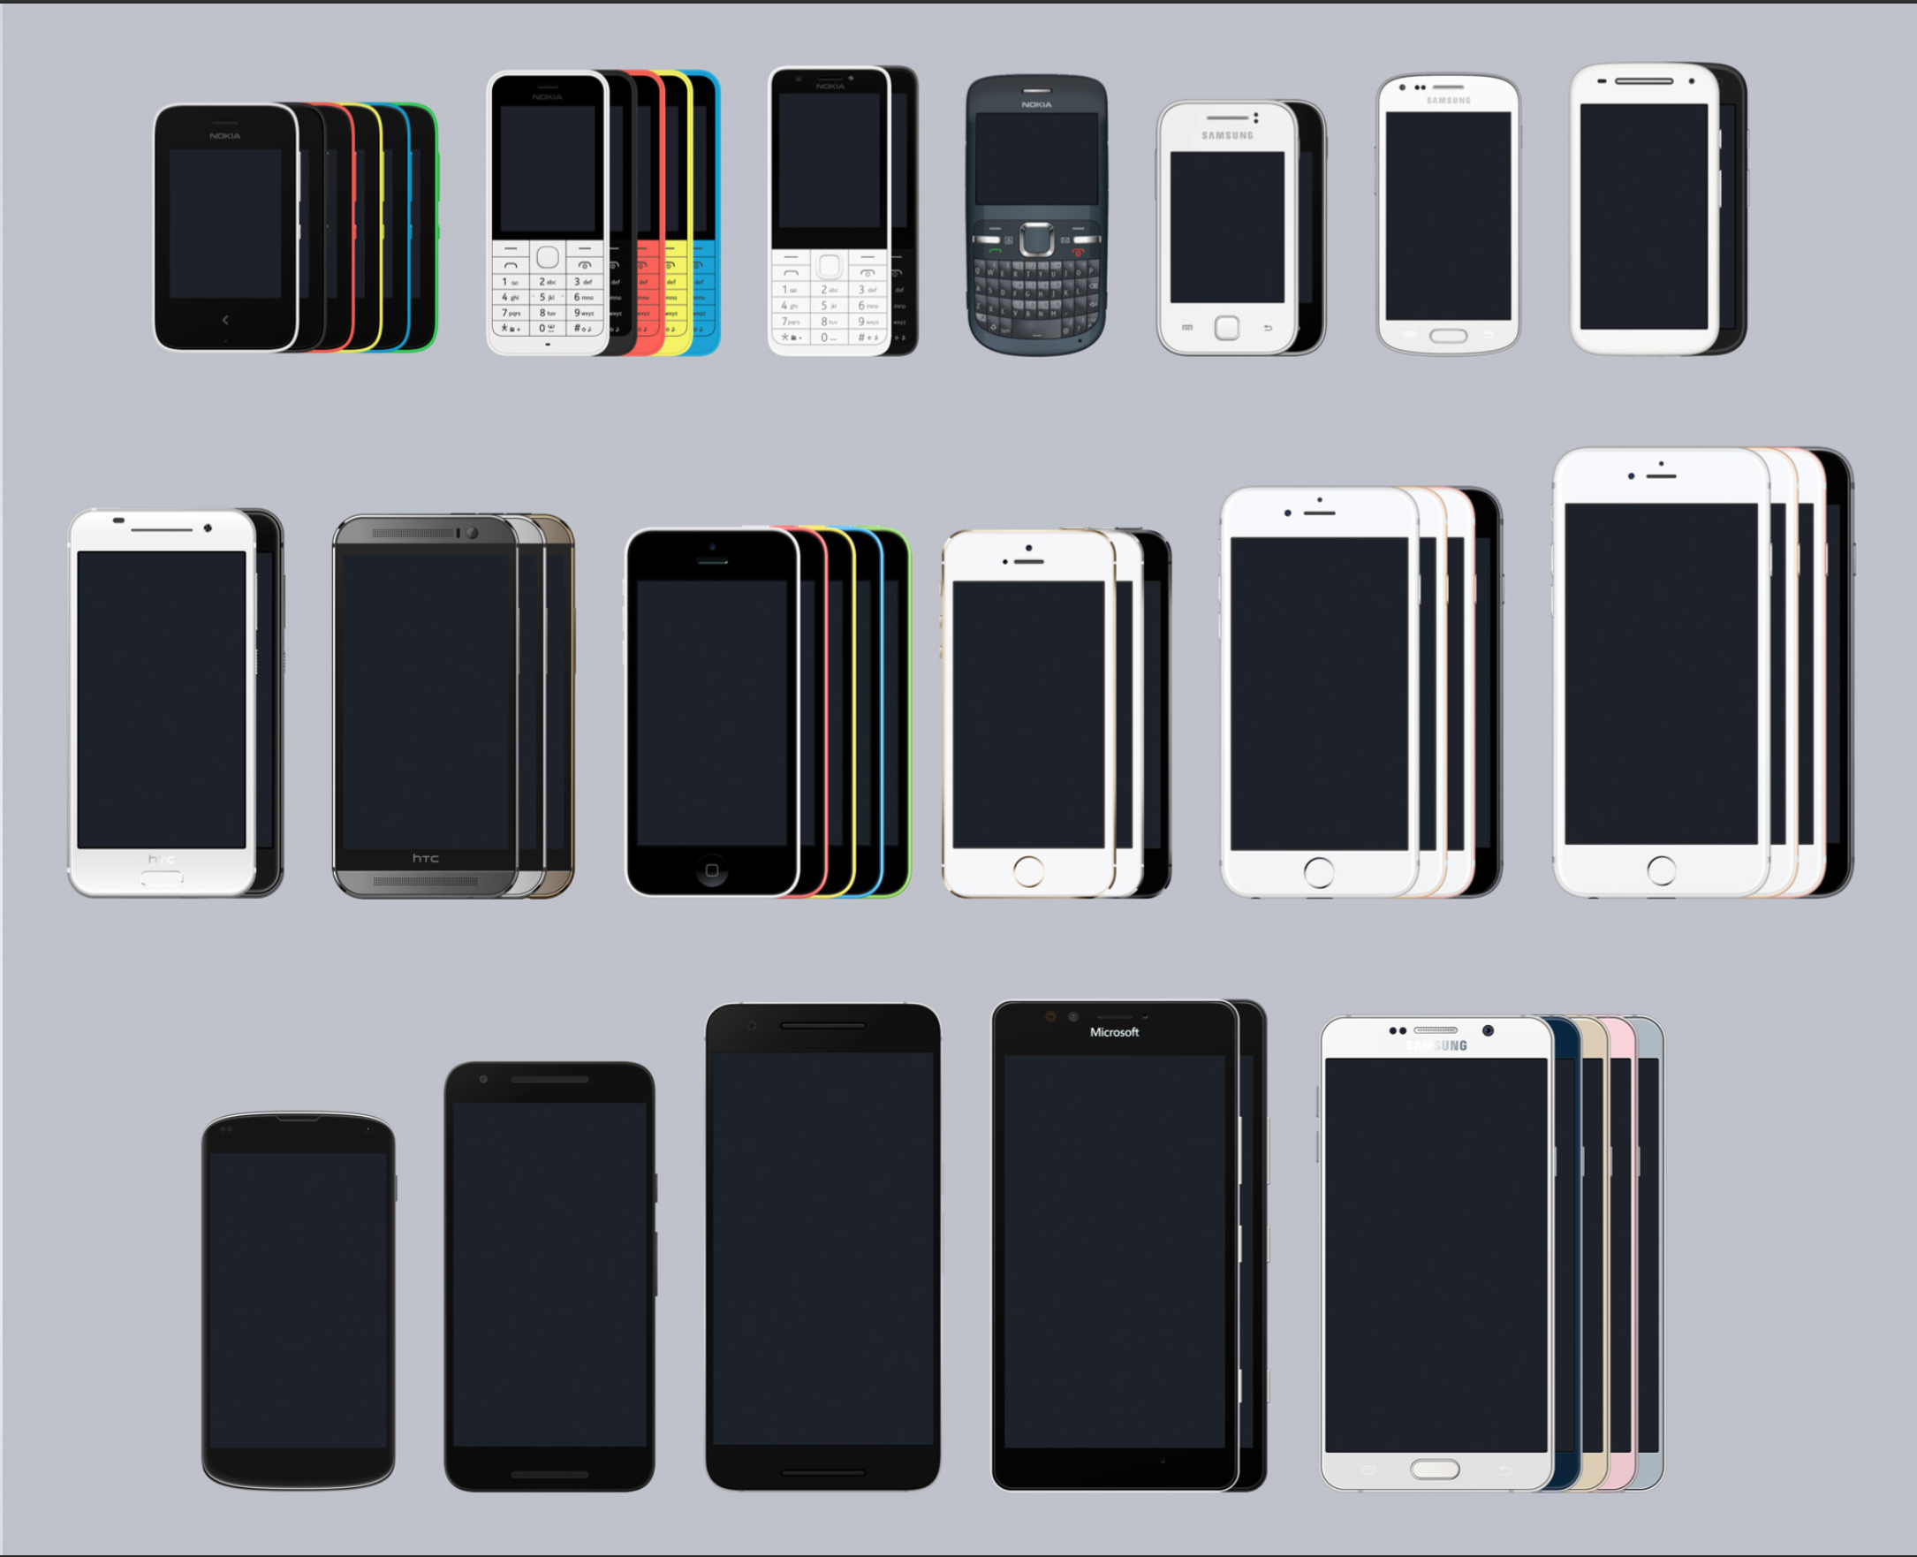
WORKS ON ALL YOUR DEVICES

